Slide 1

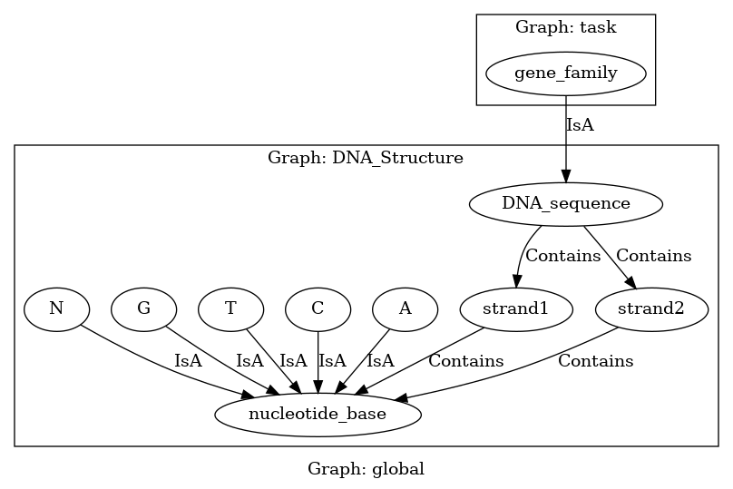
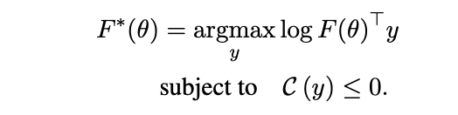
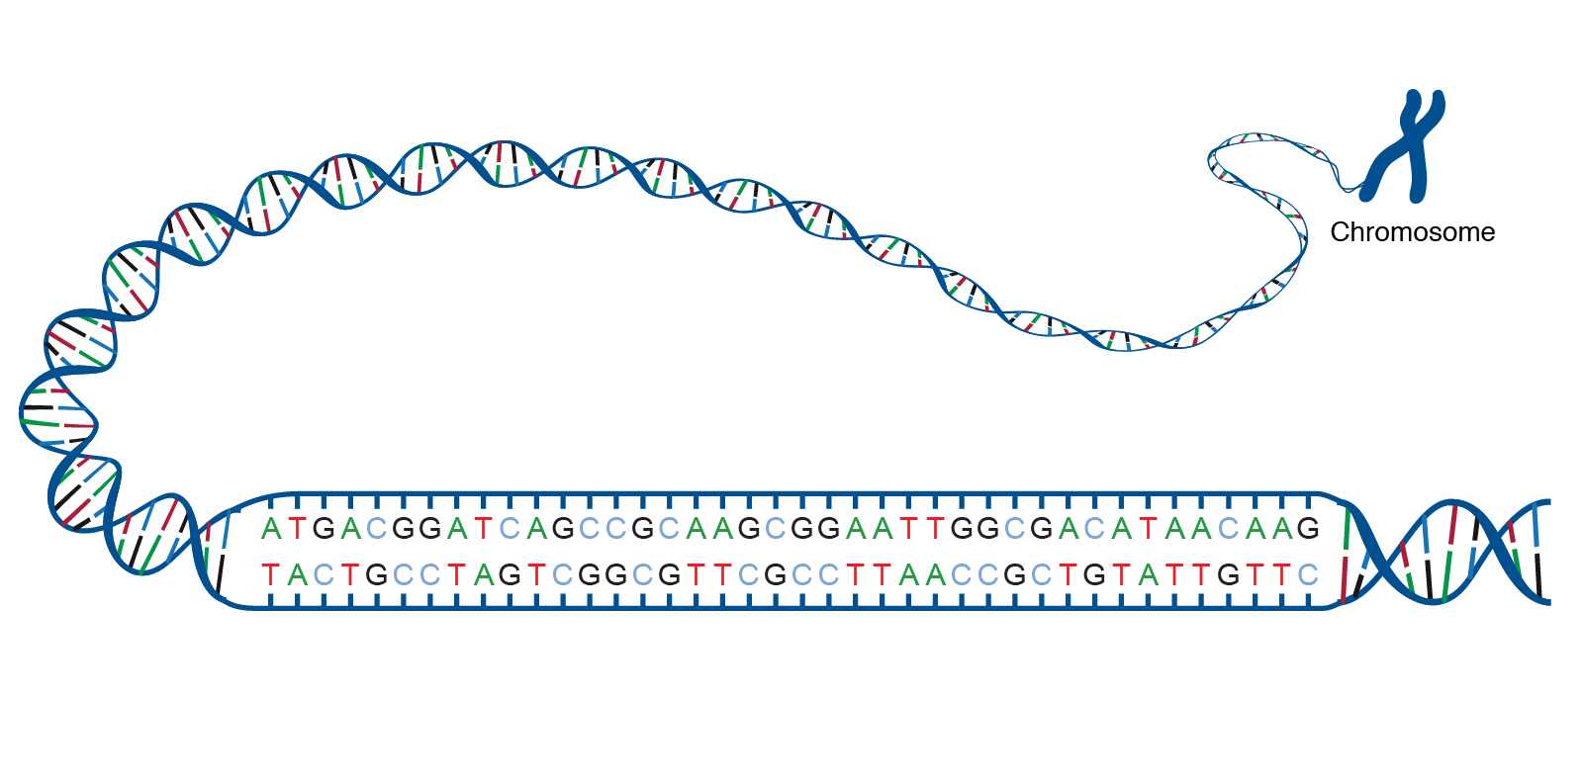
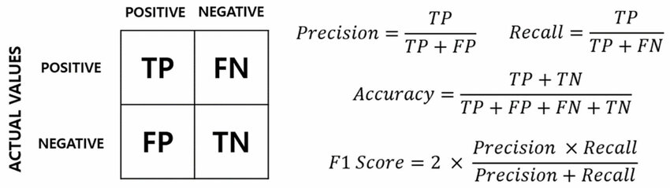
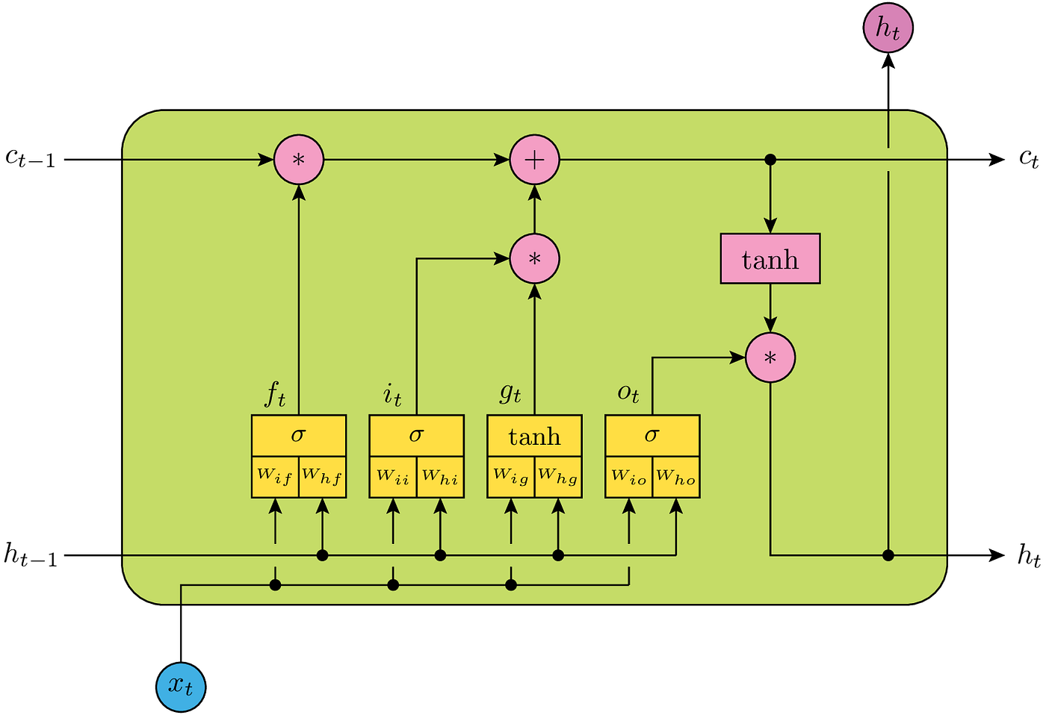
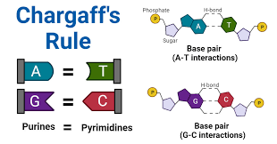
DNA Sequence Generation and Classification with Symbolic Domain Knowledge Using DomiKnowS
Sifatul Anindho and Parisa Kordjamshidi
Department of Computer Science and Engineering, Michigan State University
Motivation
Model and Dataset
Inference and Optimization
The generation and classification of DNA sequences into specific gene categories is crucial in bioinformatics, impacting genetics, medicine, and biotechnology. This study uses symbolic knowledge from domain experts, using the DomiKnowS framework to integrate this knowledge into deep learning models and attempts to highlight the advantages of domain knowledge integration in machine learning.
During the inference phase, the model processes DNA sequences to classify them into specific gene categories. We adjust its parameters to minimize the error between predicted and actual gene categories based on the constraints and relationships defined in the knowledge graph using Integer Linear Programming (ILP) solvers.
Image 1
Task Background
To model a problem in DomiKnowS, we specify the problem domain as a conceptual graph, which serves as a structured representation of domain knowledge. In this case, the graph defines several concepts: the double helix structure of DNA, the nucleotide bases that it is composed of, and the categories that they can be classified into.
Evaluation
Knowledge graph of DNA structure generated in DomiKnowS
To evaluate how well the DomiKnowS model learned this task, we ran the same task on a baseline LSTM without domain integration, and compared the outcomes. We focused on key performance metrics such as accuracy, precision, recall, and weighted F1 scores to make this comparison.
We use sensors and learners to gather data and interpret it within the context of the conceptual graph. Sensors are responsible for extracting relevant features from raw data, translating it into a format that the models can understand. Learners are the machine learning components that utilize this processed data to make predictions or classifications based on the defined domain knowledge.
The double helix structure of DNA
DNA sequences are governed by several rules, such as the complementary base pairing relationship and Chargaff’s parity rules. These are explicitly defined in DomiKnowS’s as global linear constraints.
Image 2
We are expecting to see significant improvement on all four of these metrics once the study is complete, especially when the size of the available training data is scaled down.
LSTM cells: a popular learning unit for sequence classification
References
The learning model is a multi-layer long short-term memory (LSTM) network which is designed to learn sequential data. We stack multiple LSTM layers and attach them to the knowledge graph prior to training. Model is then trained on the human genome sequence dataset imported from Kaggle.
[1] H. R. Faghihi, Q. Guo, A. Uszok, A. Nafar, E. Raisi, and P. Kordjamshidi, ‘DomiKnowS: A Library for Integration of Symbolic Domain Knowledge in Deep Learning’, arXiv [cs.LG]. 2021.
[2] H. R. Faghihi et al., ‘GLUECons: A Generic Benchmark for Learning Under Constraints’, arXiv [cs.LG]. 2023.
Chargaff’s parity rules
Presentation #907
MidSURE 2024
Contacts: anindhos@msu.edu and kordjams@msu.edu

